Slide 1


Slide 2
The cell (from Latin cella, meaning "small room") is the basic structural, functional, and biological unit of all known living organisms.
Cells are the smallest unit of life that can replicate independently, and are often called the "building blocks of life".
The study of cells is called cell biology.
Cells consist of cytoplasm enclosed within a membrane, which contains many biomolecules such as proteins and nucleic acids.
Organisms can be classified as unicellular (consisting of a single cell; including bacteria) or multicellular (including plants and animals).

Slide 3
While the number of cells in plants and animals varies from species to species, humans contain about 100 trillion (1014) cells.
Most plant and animal cells are visible only under the microscope, with dimensions between 1 and 100 micrometres.
Cells are of two types, eukaryotic, which contain a nucleus, and prokaryotic, which do not.
Prokaryotes are single-celled organisms, while eukaryotes can be either single-celled or multicellular.

Slide 4
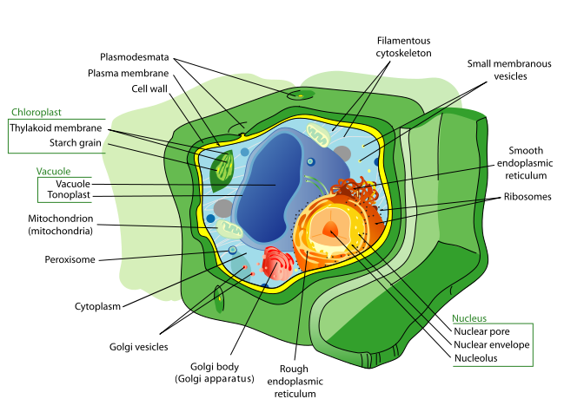


Slide 5
Plant cells are eukaryotic cells that differ in several key aspects from the cells of other eukaryotic organisms. Their distinctive features include:
  A large central vacuole, a water-filled volume enclosed by a membrane known as the tonoplast, that maintains the cell's turgor, controls movement of molecules between the cytosol and sap, stores useful material and digests waste proteins and organelles.
  A cell wall composed of cellulose and hemicellulose, pectin and in many cases lignin, is secreted by the protoplast on the outside of the cell membrane. This contrasts with the cell walls of fungi (which are made of chitin), and of bacteria, which are made of peptidoglycan.
  Specialized cell-to-cell communication pathways known as plasmodesmata, pores in the primary cell wall through which the plasmalemma and endoplasmic reticulum of adjacent cells are continuous.

Slide 6
  Plastids, the most notable being the chloroplast, which contains chlorophyll, a green-colored pigment that absorbs sunlight, and allows the plant to make its own food in the process known as photosynthesis. Other types of plastids are the amyloplasts, specialized for starch storage, elaioplasts specialized for fat storage, and chromoplasts specialized for synthesis and storage of pigments.
  The sperm of bryophytes and pteridophytes, cycads and Ginkgo have flagella, but higher plants, (including Gymnosperms and flowering plants) lack the flagella and centrioles.

Slide 7
Parenchyma cells are living cells that have functions ranging from storage and support to photosynthesis and phloem loading (transfer cells).
Apart from the xylem and phloem in their vascular bundles, leaves are composed mainly of parenchyma cells.
Some parenchyma cells, are specialized for light penetration and focusing or regulation of gas exchange, but others are among the least specialized cells in plant tissue, and may remain totipotent, capable of dividing to produce new populations of undifferentiated cells, throughout their lives.
Parenchyma cells have thin, permeable primary walls enabling the transport of small molecules between them.
Parenchyma cells that contain many chloroplasts and are concerned primarily with photosynthesis are called chlorenchyma cells.

Slide 8
Collenchyma cells – collenchyma cells are alive at maturity and have only a primary wall. These cells mature from meristem derivatives that initially resemble parenchyma, but differences quickly become apparent.
Plastids do not develop, and the secretory apparatus (ER and Golgi) proliferates to secrete additional primary wall. The wall is most commonly thickest at the corners, where three or more cells come in contact, and thinnest where only two cells come in contact, though other arrangements of the wall thickening are possible.
Collenchyma cells are typically quite elongated.

Slide 9
Sclerenchyma cells – Sclerenchyma cells (from the Greek skleros, hard) are hard and tough cells with a function in mechanical support.
They are of two broad types – sclereids or stone cells and fibres.
The cells develop an extensive secondary cell wall that is laid down on the inside of the primary cell wall.
The secondary wall is impregnated with lignin, making it hard and impermeable to water.
Thus, these cells cannot survive for long' as they cannot exchange sufficient material to maintain active metabolism.
Sclerenchyma cells are typically dead at functional maturity, and the cytoplasm is missing, leaving an empty central cavity.

Slide 10

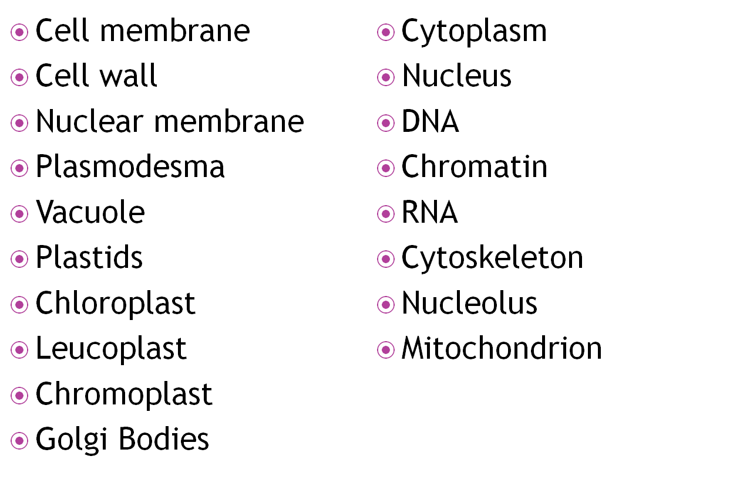

Slide 11
Plant cells are eukaryotic cells, or cells with a membrane-bound nucleus.
Unlike prokaryotic cells, the DNA in a plant cell is housed within the nucleus.
In addition to having a nucleus, plant cells also contain other membrane-bound organelles, or tiny cellular structures, that carry out specific functions necessary for normal cellular operation.
Organelles have a wide range of responsibilities that include everything from producing hormones and enzymes to providing energy for a plant cell.

Slide 12
Plant cells are generally larger than animal cells.
While animal cells come in various sizes and tend to have irregular shapes, plant cells are more similar in size and are typically rectangular or cube shaped.
A plant cell also contains structures not found in an animal cell. Some of these include a cell wall, a large vacuole, and plastids.
Plastids, such as chloroplasts, assist in storing and harvesting needed substances for the plant.
Animal cells also contain structures such as centrioles, lysosomes, and cilia and flagella that are not typically found in plant cells.

Slide 13
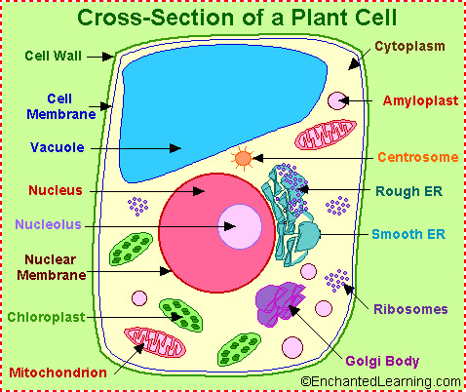

Slide 14

The following are examples of structures and organelles that can be found in typical plant cells:
  Cell Wall - outer covering of the cell that protects the plant cell and gives it shape.
  Chloroplast - the sites of photosynthesis in a plant cell. They contain chlorophyll, a green pigment that absorbs energy from sunlight.
  Cytoplasm - gel-like substance within the cell membrane containing water, enzymes, salts, organelles, and various organic molecules.
  Cytoskeleton - a network of fibers throughout the cytoplasm that helps the cell maintain its shape and gives support to the cell.

Slide 15
  Endoplasmic Reticulum (ER) - extensive network of membranes composed of both regions with ribosomes (rough ER) and regions without ribosomes (smooth ER).
  Golgi Complex - responsible for manufacturing, storing and shipping certain cellular products.
  Microtubules - hollow rods that function primarily to help support and shape the cell.
  Mitochondria - this organelle generates energy for the cell.
  Nucleus - membrane bound structure that contains the cell's hereditary information.
  Nucleolus - structure within the nucleus that helps in the synthesis of ribosomes.
  Nucleopore - tiny hole within the nuclear membrane that allows nucleic acids and proteins to move into and out of the nucleus.

Slide 16
  Peroxisomes - tiny structures bound by a single membrane that contain enzymes that produce hydrogen peroxide as a by-product. These structures are involved in plant processes such as photorespiration.
  Plasmodesmata - pores or channels between plant cell walls that allow molecules and communication signals to pass between individual plant cells.
  Ribosomes - consisting of RNA and proteins, ribosomes are responsible for protein assembly.
  Vacuole - structure in a plant cell that provides support and participates in a variety of cellular functions including storage, detoxification, protection, and growth. When a plant cell matures, it typically contains one large liquid-filled vacuole.

